Slide 1


Name : Pratiksha P Patil
Class : TY CSE B
Roll no. : 19
Topic : Peephole Optimization.
Guided By
Mr. Sameer Tamobli

Slide 2
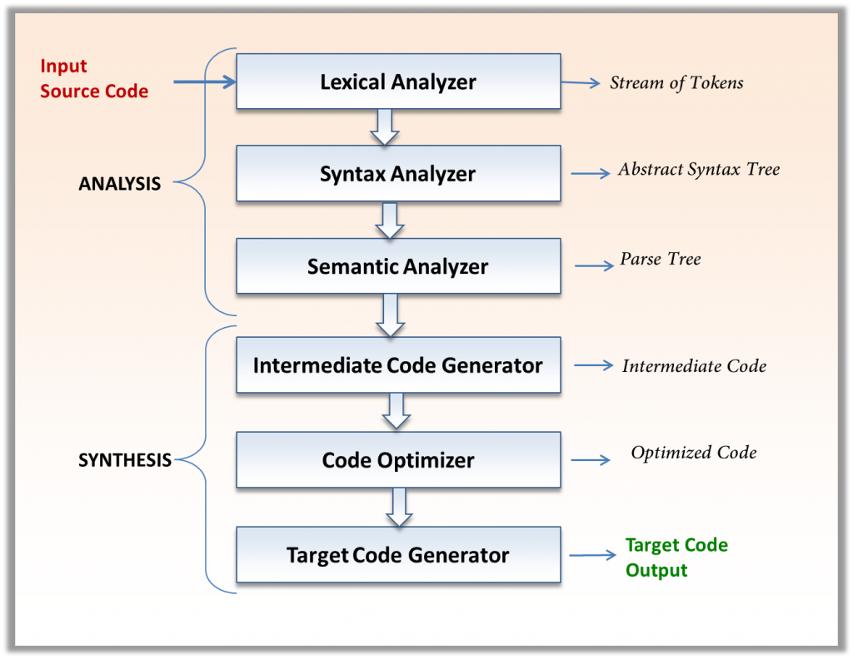
Name : Pratiksha P Patil
Class : TY CSE B
Roll no. : 19
Topic : Peephole Optimization.
Guided By
Mr. Sameer Tamobli
Peephole optimization is a type of code Optimization performed on a small part of the code. It is performed on a very small set of instructions in a segment of code.
When to Optimize?
Optimization of the code is often performed at the end of the development stage since it reduces readability and adds code that is used to increase performance.

Slide 3
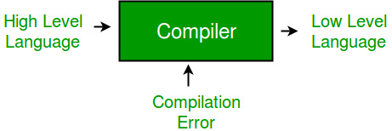
Peephole optimization
Peephole optimization is a type of code Optimization performed on a small part of the code. It is performed on a very small set of instructions in a segment of code.
When to Optimize?
Optimization of the code is often performed at the end of the development stage since it reduces readability and adds code that is used to increase performance.
Why Optimize?
Optimizing an algorithm is beyond the scope of the code optimization phase. So the program is optimized. And it may involve reducing the size of the code. So, optimization helps to:
Reduce the space consumed and increases the speed of compilation.
Manually analyzing datasets involves a lot of time. Hence, we make use of software like Tableau for data analysis. Similarly, manually performing the optimization is also tedious and is better done using a code optimizer.
An optimized code often promotes re-usability.

Slide 4
Types of Code Optimization
The optimization process can be broadly classified into two types:
Machine Independent Optimization: This code optimization phase attempts to improve the intermediate code to get a better target code as the output. The part of the intermediate code which is transformed here does not involve any CPU registers or absolute memory locations.
Machine Dependent Optimization: Machine-dependent optimization is done after the target code has been generated and when the code is transformed according to the target machine architecture. It involves CPU registers and may have absolute memory references rather than relative references. Machine-dependent optimizers put efforts to take maximum advantage of the memory hierarchy.
Why Optimize?
Optimizing an algorithm is beyond the scope of the code optimization phase. So the program is optimized. And it may involve reducing the size of the code. So, optimization helps to:
Reduce the space consumed and increases the speed of compilation.
Manually analyzing datasets involves a lot of time. Hence, we make use of software like Tableau for data analysis. Similarly, manually performing the optimization is also tedious and is better done using a code optimizer.
An optimized code often promotes re-usability.

Slide 5
Types of Code Optimization
The optimization process can be broadly classified into two types:
Machine Independent Optimization: This code optimization phase attempts to improve the intermediate code to get a better target code as the output. The part of the intermediate code which is transformed here does not involve any CPU registers or absolute memory locations.
Machine Dependent Optimization: Machine-dependent optimization is done after the target code has been generated and when the code is transformed according to the target machine architecture. It involves CPU registers and may have absolute memory references rather than relative references. Machine-dependent optimizers put efforts to take maximum advantage of the memory hierarchy.
Ways to Optimize Code
CoCompile Time Evaluation: Some expressions involving constants can be computed at compile time, reducing runtime overhead. Example: A = 2*(22.0/7.0)*r is evaluated during compilation.
Variable Propagation: If a variable is assigned another variable's value and remains unchanged, it can be directly replaced, reducing redundant assignments. Example: d = x * b + 4 becomes d = a * b + 4.
Constant Propagation: If a variable is assigned a constant and never changes, it is replaced by its constant value. Example: if(k) go to L3; becomes go to L3; if k = 2.
Constant Folding: Expressions with constant values are computed at compile time. Example: #define k 5, x = 2 * k results in x = 10.mpile Time Evaluation: Some expressions involving constants can be computed at compile time, reducing runtime overhead. Example: A = 2*(22.0/7.0)*r is evaluated during compilation.

Slide 6
Ways to Optimize Code
Copy Propagation: If one variable is assigned another and remains unchanged, the first variable can be replaced by the second. Example: d = x * b + 4 is optimized to d = a * b + 4.
Common Subexpression Elimination: Repeated computations of the same expression are eliminated by storing the result. Example: a * b and x * b are computed once instead of twice.
Dead Code Elimination: Code that does not affect the program's outcome is removed. Example: Unused variables or redundant assignments are deleted.
Unreachable Code Elimination: Code that can never be executed is removed. Example: Code after return is deleted, as it will never run.
CoCompile Time Evaluation: Some expressions involving constants can be computed at compile time, reducing runtime overhead. Example: A = 2*(22.0/7.0)*r is evaluated during compilation.
Variable Propagation: If a variable is assigned another variable's value and remains unchanged, it can be directly replaced, reducing redundant assignments. Example: d = x * b + 4 becomes d = a * b + 4.
Constant Propagation: If a variable is assigned a constant and never changes, it is replaced by its constant value. Example: if(k) go to L3; becomes go to L3; if k = 2.
Constant Folding: Expressions with constant values are computed at compile time. Example: #define k 5, x = 2 * k results in x = 10.mpile Time Evaluation: Some expressions involving constants can be computed at compile time, reducing runtime overhead. Example: A = 2*(22.0/7.0)*r is evaluated during compilation.

Slide 7
Copy Propagation: If one variable is assigned another and remains unchanged, the first variable can be replaced by the second. Example: d = x * b + 4 is optimized to d = a * b + 4.
Common Subexpression Elimination: Repeated computations of the same expression are eliminated by storing the result. Example: a * b and x * b are computed once instead of twice.
Dead Code Elimination: Code that does not affect the program's outcome is removed. Example: Unused variables or redundant assignments are deleted.
Unreachable Code Elimination: Code that can never be executed is removed. Example: Code after return is deleted, as it will never run.
Function Inlining: Instead of calling a function, its code is directly inserted where used, reducing function call overhead. Example: inline functions in C++.
Function Cloning: Multiple optimized versions of a function are created for different input cases. Example: Function overloading in C++.
Induction Variable & Strength Reduction: Optimizing loop variables and replacing expensive operations with simpler ones. Example: a = a * 16 is rewritten as a = a << 4.

Slide 8
Advantages of Code Optimization
Improved performance: Code optimization can result in code that executes faster and uses fewer resources, leading to improved performance.
Reduction in code size: Code optimization can help reduce the size of the generated code, making it easier to distribute and deploy.
Increased portability: Code optimization can result in code that is more portable across different platforms, making it easier to target a wider range of hardware and software.
Reduced power consumption: Code optimization can lead to code that consumes less power, making it more energy-efficient.
Improved maintainability: Code optimization can result in code that is easier to understand and maintain, reducing the cost of software maintenance.
Function Inlining: Instead of calling a function, its code is directly inserted where used, reducing function call overhead. Example: inline functions in C++.
Function Cloning: Multiple optimized versions of a function are created for different input cases. Example: Function overloading in C++.
Induction Variable & Strength Reduction: Optimizing loop variables and replacing expensive operations with simpler ones. Example: a = a * 16 is rewritten as a = a << 4.

Slide 9
Disadvantages of Code Optimization
Increased compilation time: Code optimization can significantly increase the compilation time, which can be a significant drawback when developing large software systems.
Increased complexity: Code optimization can result in more complex code, making it harder to understand and debug.
Potential for introducing bugs: Code optimization can introduce bugs into the code if not done carefully, leading to unexpected behavior and errors.
Difficulty in assessing the effectiveness: It can be difficult to determine the effectiveness of code optimization, making it hard to justify the time and resources spent on the process.
Advantages of Code Optimization
Improved performance: Code optimization can result in code that executes faster and uses fewer resources, leading to improved performance.
Reduction in code size: Code optimization can help reduce the size of the generated code, making it easier to distribute and deploy.
Increased portability: Code optimization can result in code that is more portable across different platforms, making it easier to target a wider range of hardware and software.
Reduced power consumption: Code optimization can lead to code that consumes less power, making it more energy-efficient.
Improved maintainability: Code optimization can result in code that is easier to understand and maintain, reducing the cost of software maintenance.

Slide 10
Disadvantages of Code Optimization
Increased compilation time: Code optimization can significantly increase the compilation time, which can be a significant drawback when developing large software systems.
Increased complexity: Code optimization can result in more complex code, making it harder to understand and debug.
Potential for introducing bugs: Code optimization can introduce bugs into the code if not done carefully, leading to unexpected behavior and errors.
Difficulty in assessing the effectiveness: It can be difficult to determine the effectiveness of code optimization, making it hard to justify the time and resources spent on the process.

Slide 11
Thank you..

